Slide 1
MarketingGuru
Software Engineering
Faculty of Engineering
Ben Gurion University of the Negev

Slide 2
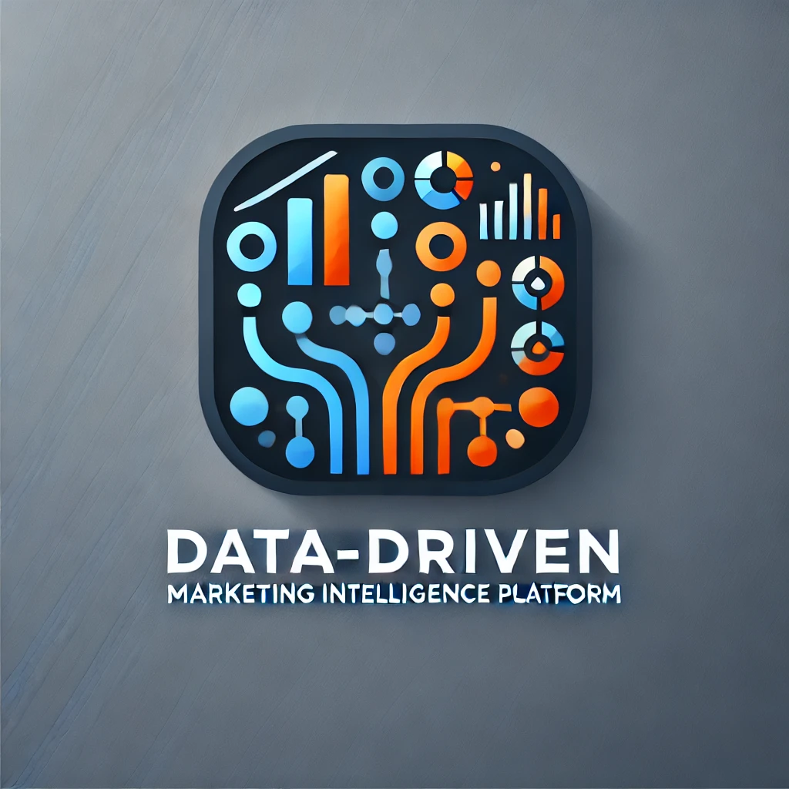
Team Details
Student Name | ID | Email | Phone | Signature
Evyatar Kopans | 209130335 | kopansev@post.bgu.ac.il‏ | 052-790-3414
Yuval Goldstein | 208668442 | golyuval@post.bgu.ac.il | 052-725-2886
Ron Franco | 206556045 | ronfr@post.bgu.ac.il | 055-954-2077
Peleg Ben Barak | 207233560 | benbapel@post.bgu.ac.il | 050-679-2401

Slide 3
Customer:
User1st
User1st’s Representative: Ariel Orbach
Role: Co-Founder CTO
Email: ariel.orbach@user1st.com
Phone: Number +972-(0)5203000970
Address: Azrieli Sarona Tower - Derech Menachem Begin 121, Tel Aviv-Yafo
Other advisors will also be appointed for specific purposes such as: CMO, Product Department, Compliance, Backend & Frontend architects, infrastructure / DevOps / SRE / Data / Sales)

Slide 4
Introduction
In today's competitive digital landscape, data-driven strategies are essential for optimizing marketing efforts.
Traditional methods lack the agility to adapt to changing markets and customer behaviors.
This project aims to build a data-centric platform offering real-time marketing insights, leveraging analytics and machine learning to improve performance, eliminate inefficiencies, and reduce costs.

Slide 5
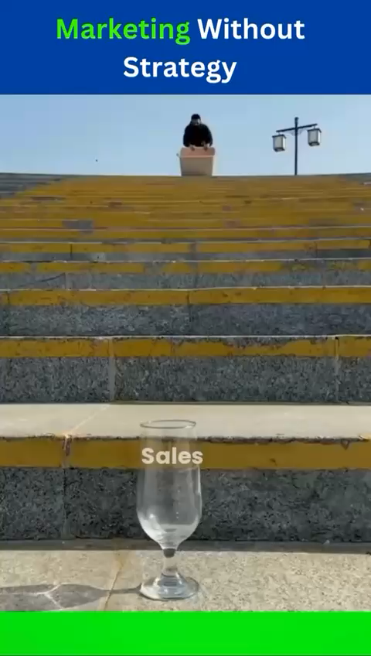
What “Marketing to everyone” gets you:

Slide 6
Project Motivation
The marketing domain has shifted from intuition-based decision-making to data-driven approaches.
What do we want to achieve?
Enhanced lead generation !
Increased customer engagement !
Improved product development
and positioning !
Search engine optimization !

Slide 7
Our solution
A Data-Driven Marketing Intelligence Platform, called “MarketingGuru”!
Our system aims to solve the problems of intuition-based approaches by gathering and analyzing important user data (Lead Analysis) in Order to assemble an accurate ICP.

Slide 8
Our solution’s functionalities
what data we want to collect?
Gathering frequently searched keywords to improve SEO (from google analytics, LinkedIn premium, Meta developers).
Geographic users’ location distribution (google analytics)
Demographic users’ data (google analytics: gender, age, education, profession, mobile/web user ..)
Manually filled forms by potential clients/buyers to detect our ICP (a form filled by an interested user fits out ICP better than an intrigued user browsing LinkedIn).
Easy extraction of user data from social network campaigns.

Slide 9
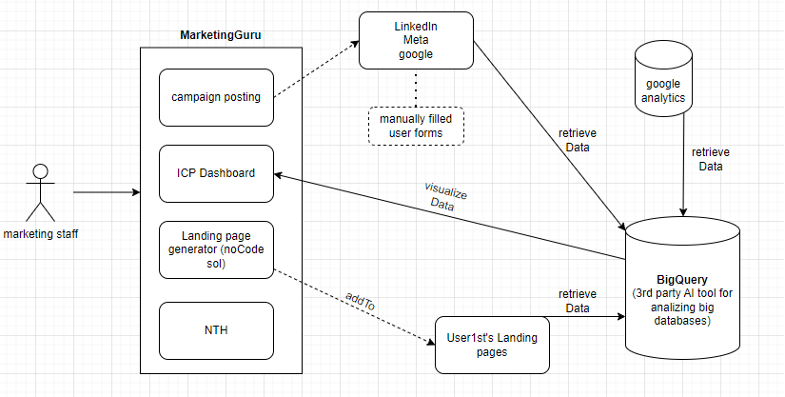
Phase 1: MarketingGuru

Slide 10
additional functionalities phase 2
Nice to have!
Automated crawlers searching for tech-influencers and client companies' representatives. (for example – zoom info’s marketplace contains a lot of commercial companies' websites – and we can use tools like “wave” to scan the site for accessibility flaws).
Use an AI model with all our collected data to grant the lead Score for each user.
ROI analysis and stopping point calc per campaign (online algorithms – check).
Canceling actions performed by the User in our site (from google analytics) and overall Website analytics (heatmap).
The system will handle a stateful key-value storage (key – userIP, value – user Cookies)

Slide 11
Project goals
Project goals
Develop an accurate ICP
Help the sales staff with their day-to-day workload
Real-Time Analytics & Visualization
Performance Benchmarking

Slide 12
Current Students Resources
Dev tools:
Access to User1st’s google analytics
premium LinkedIn profile
meta-accounts
cloud account
BigQuery licence
And:
Educated Staff
Agility in Learning
Support from Academia

Slide 13
Project’s Risk Assesment (and how we’ll overcome)
Challenge | How to overcome?
New Programming Languages & Technologies | Provide hands-on training sessions, pair programming, and access to online tutorials and resources to accelerate the learning curve.
UTM Analysis Complexity | Use automated tools for UTM tracking and regularly validate the accuracy of UTM data to ensure precise attribution.
Big Data Analysis | Auto didactive learning process with a healthy “try & fail” work ethic
Adopting Machine Learning Models(BigQuery) | Continuously refine models with diverse datasets and validate their accuracy against real-world outcomes.

Slide 14







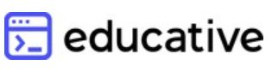



Project’s Environments and Language
Backend
Frontend
Our learning platforms:

Slide 15
Evaluation and Testing Plan
Unit Testing on individual classes and components and individual modules
QA testing
Acceptance Testing for system requirements
Manual UI/UX Testing with users
Test for security vulnerabilities
Test performance under high user load
Notes:
גל

Slide 16
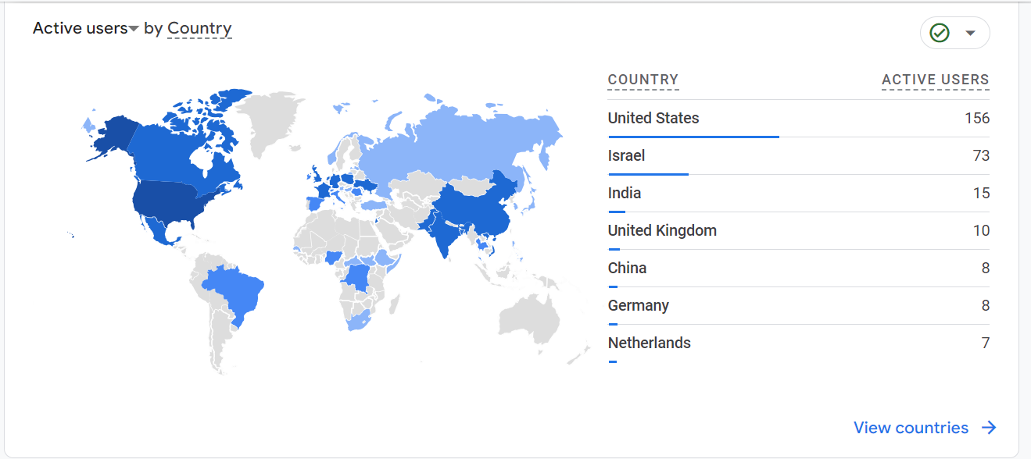
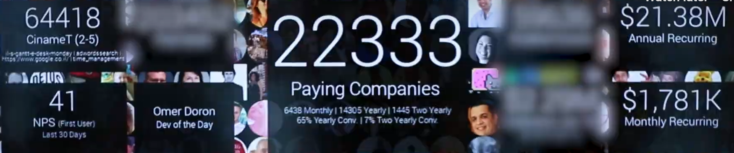
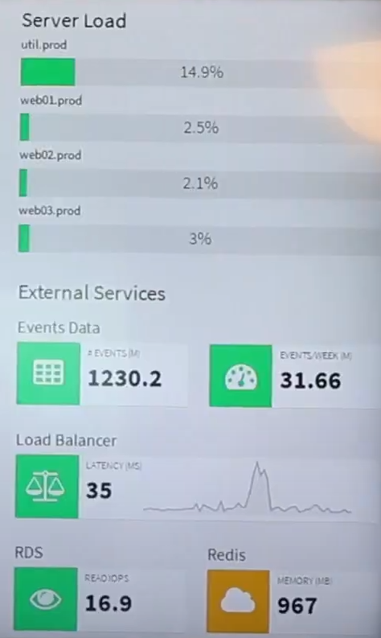
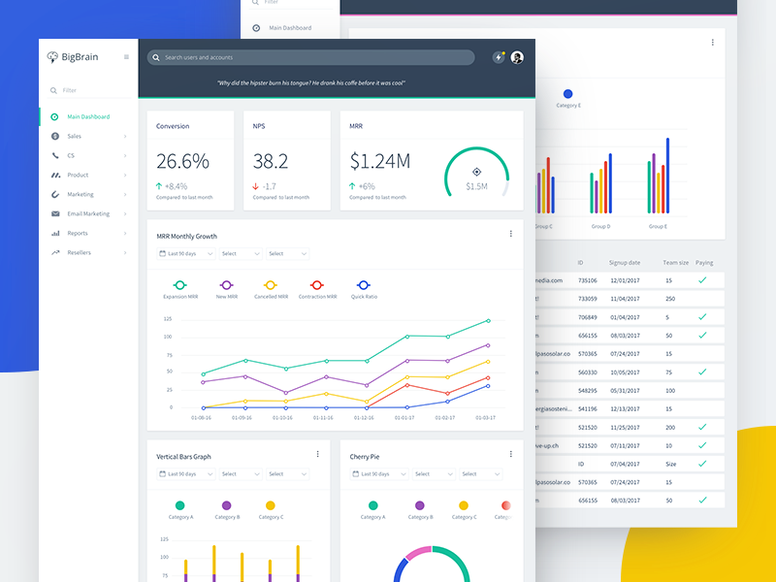
UI Example Of a Marketing Intelligence System

Slide 17
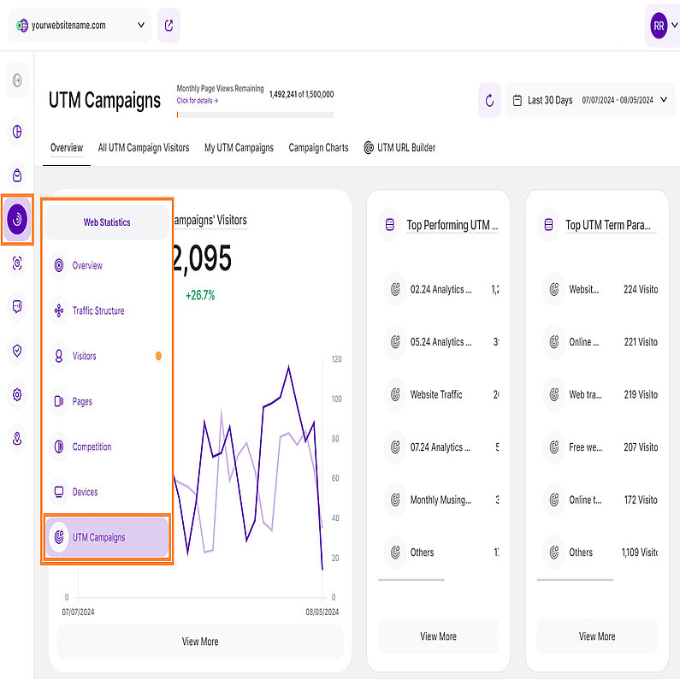
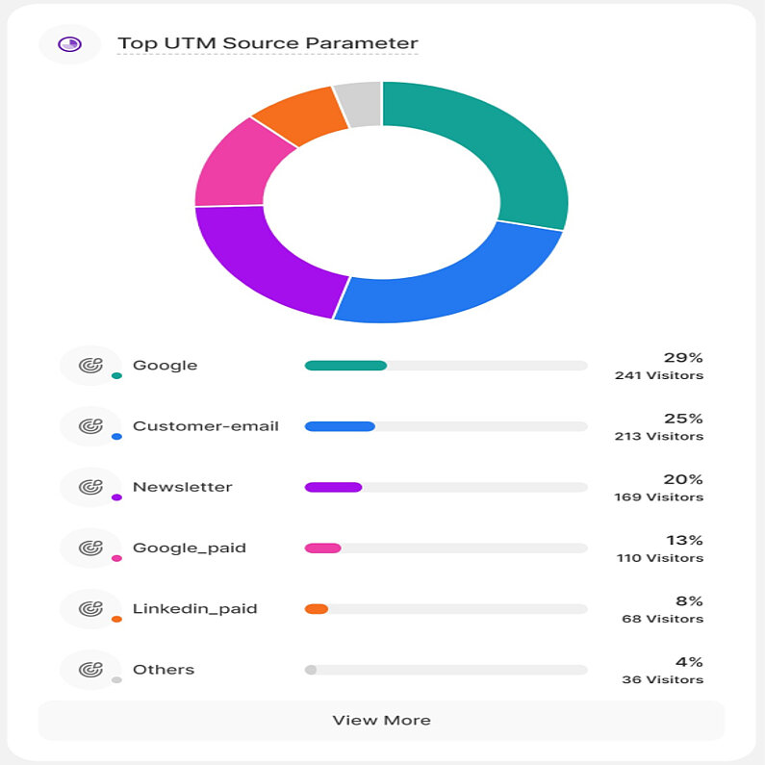
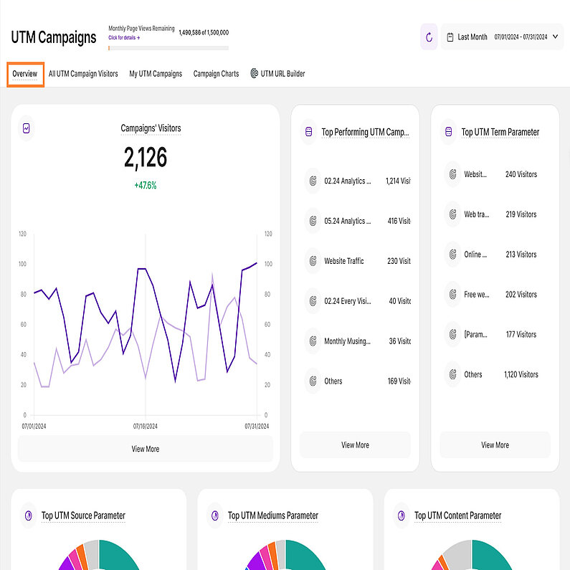
UI Example (UTM parameters handing)
* More advanced and thorough design will be published after the PRD review and requirements gathering.

Slide 18
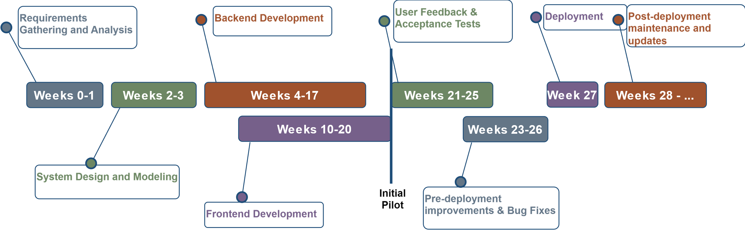
Project Timeline
Phase 1 complete
Phase 2 start

